Slide 1
High Performance Inferencing for LLMs

Slide 2
Abstract
Inferencing has become ubiquitous across cloud, regional, edge, and device environments, powering a wide spectrum of AI use cases spanning vision, language, and traditional machine learning applications. In recent years, Large Language Models (LLMs), initially developed for natural language tasks, have expanded to multimodal applications including vision speech, reasoning and planning each demanding distinct service-level objectives (SLOs). Achieving high-performance inferencing for such diverse workloads requires both model-level and system-level optimizations.
This talk focuses on system-level optimization techniques that maximize token throughput , achieve user experience metrics and inference service-provider efficiency. We review several recent innovations including KV caching, Paged/Flash/Radix Attention, Speculative Decoding, P/D Disaggregation and KV Routing, and explain how these mechanisms enhance performance by reducing latency, memory footprint, and compute overhead. These techniques are implemented in leading open-source inference frameworks such as vLLM, SGLang, Hugging Face TGI, and NVIDIA NIM, which form the backbone of large-scale public and private LLM serving platforms.
The use of GPU Training, Inference and Analysis clusters with Multi-Instance-GPU's (MIG), and Federated Models with QML applications is now become practical.
Attendees will gain a practical understanding of the challenges in delivering scalable, low-latency LLM inference, and of the architectural and algorithmic innovations driving next-generation high-performance inference systems.

Slide 3
Bio
Ravishankar Ravindran has over 24 years of experience contributing to advanced data networking products and research. He is an accomplished Professional currently on an advisory role to eOTF as Technical Director. Previous to this, he was the Telco Architect at F5, he led the system architecture and design for F5’s Telco Cloud platform, supporting 5G vRAN and Core workloads. His work included active participation in standards development, particularly in the O-RAN Alliance's Working Group 6 (Cloud Architecture and Orchestration), and contributions to the Nephio project under the Linux Foundation Networking (LFN), focusing on Kubernetes-based domain orchestration for Telco use cases spanning RAN, Core, and Transport networks.
Previously, as Chief Architect at Corning Inc., he focused on the architecture and design of disaggregated RAN (CU/DU) for third-party cloud platforms and contributed to the integration of vDU with third-party O-RUs based on O-RAN’s Open Fronthaul (O-FH) specifications, with a focus on the M-plane. Prior to that, he served as Chief Architect at Sterlite Technologies (STL), where he was responsible for the end-to-end design of multi-tier RAN Intelligent Controllers (RICs), aimed at optimizing large-scale RAN systems through xApps such as Mobile Load Balancing, Traffic Steering, and Dynamic Spectrum Sharing.
Before this, he led the Future and Network Theory Lab at Futurewei (Huawei Technologies) as a Principal Researcher, focusing on efficient networking for cloud robotics, autonomous vehicles, and drone systems. His research emphasized next-generation networking requirements, including information-centric networking (ICN), software-defined networking (SDN), and network virtualization—particularly addressing challenges in mobility, content distribution, and content-centric routing protocols.
Prior to this role, he was part of the CTO Office at Nortel, where he was a member of the Advanced Technology Group, working on research areas such as control plane routing protocols for IP/(G)MPLS, L2/L3 Virtualization services, scheduling problems in 4G wireless, and end-to-end QoE/QoS engineering for multimedia services. He later served as a Technology Advisor at Avaya.
Ravindran has been an active contributor to numerous standardization bodies including the IETF, ITU, ATIS, the O-RAN Alliance, and LFN’s Nephio. He participated in the ITU’s Focus Group on IMT-2020, helping to define early standards for 5G. He holds a Ph.D. in Electrical Engineering from Carleton University, has served as an editor for the Springer Photonic Network Communications (PNET) journal, and has been part of technical program committees for top-tier conferences. Ravindran is a (co-)inventor on over 90 granted and filed U.S. patents (with additional patents pending) and has authored over 50 peer-reviewed papers in IEEE and ACM venues. His research and patents have been cited over 4,000 times, according to his Google Scholar profile.

Slide 4
Agenda
Inference and Performance Objectives
Transformer recap
Inferencing System Architecture
Model versus System-centric Optimization
System Optimization Techniques for LLM Inferencing
KV Caching/Prefix Caching
Continuous/Prefix Chunking Batching
Paged/Radix/Flash Attention
Speculative/Constraint Decoding
Prefill/Decode Disaggregation
KV Routing and Load Balancing
Large Scale Expert Paralleliism
vLLM and SGLang Inferencing Platforms
Conclusions

Slide 5
Distributed Inferencing
Inferencing is when a trained model (Transformer, CNN, ML etc.) are used in production handling new data inputs serving a given use case
Inferencing for LLM’s has become a center of focus as Transformers have been proven to handle Language, Vision, Speech tasks quite well
With this also the SLOs for the end user becomes heterogenous considering the different use cases.
Chatbots, Reasoning/Planning, Image Recognition, Speech Translation, Contact Center etc
Distributed Inferencing has two meaning
Inferencing at different layers of the network hierarchy - central/region/edge/device etc.
Inference model itself is distributed across devices (relevant to this talk)

Slide 6
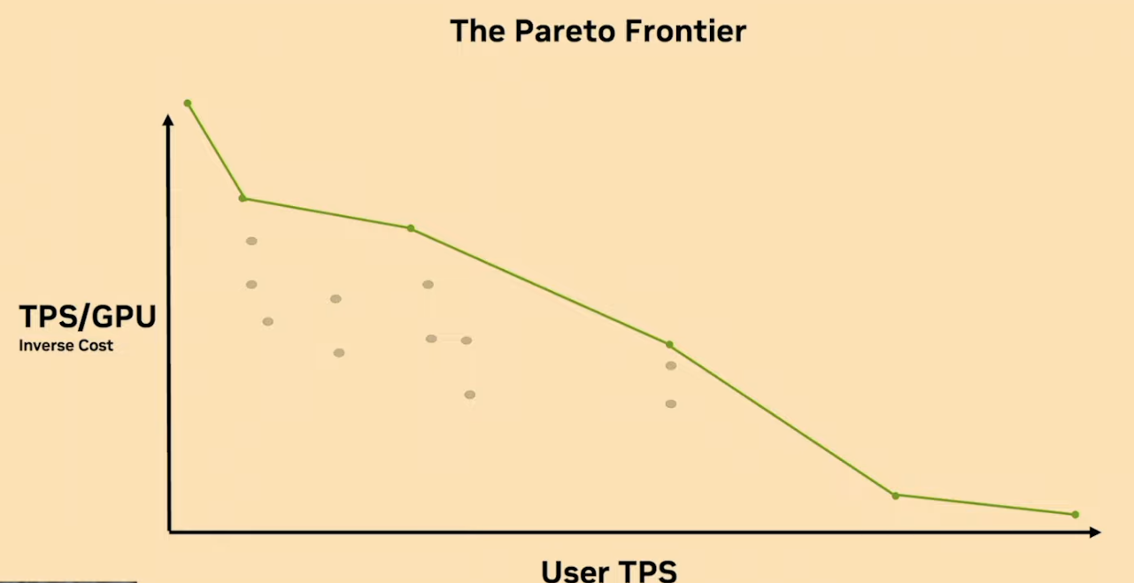
Performance Objectives for LLM Inferencing
Ideal Point
Performance Metrics
Time for First Token (TFTT)
From an end-user’s perspective it is from the moment Prompt is sent to the time the first token is received
Inter-token Latency (ITL)
The latency between tokens
Token Throughput
From end-user perspective its received tokens/s, and model service provider its aggregate tokens/s for a set of users.
Accuracy*:
Proportion of instances over a set of querys when the inferencing engine gives a satisfactory response.
Optimization Objective
The optimization objective is to find an operating point so that that the SLO (user latency) is met, while maximizing system throughput (or minimize the energy consume)
Pareto frontier for an inferencing system demonstrates a trade-off between user experience and inferencing system’s throughput
Lower Latency
- Different choice of LLM, Batching, scheduling, hyper parameters leads to different operating point considering system constraints
- For desired user latency range e.g. (20-50 tokens/s). Maximize the TPS/GPU (reducing cost/token)

Slide 7
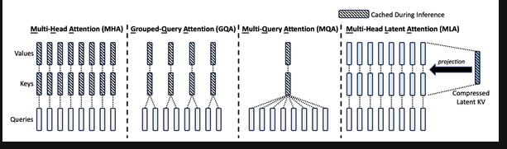
Model-centric vs System-Centric Optimization
Model Centric optimizes the base Transformer model for smaller memory usage , latency, compute efficiency or disaggregation
Accuracy implications
Mixture-of-Experts
Group Query Attention
Multi-head Latent Attention
Cross-layer/Local Attention
Quantization etc.
System-Centric Optimization
Genrally model-agnostic
KV Caching
Continuous Batching
Paged/Radix/Flash Attention
Speculative Decoding
P/D Dissagregation
KV Routing
Reduced KV Cache requirement
Examples of Model-Centric Optimization
Node/Network Level (e.g. P/D Diss. + NIXL + APP Protocols)
Node Level (Inference Engine, Schedular, Prefix Caching, Paging, Parallelism, etc.)
Transformer Level (Parallelism /Attention/Speculative Decode.)
Kernel (CUDA , Flash Attention, GEMM, etc.)
GPU/CPU/MEMORY/Network (Virtualization/Multi-Tenancy)
Fig from [1] in Reference.
System-centric Optimization for Inferencing
Notes:
Another notable advancement in KV cache efficiency is multihead latent attention (MLA), introduced by DeepSeek, which is the rightmost setup in Figure 6-10. The key difference between MLA and other variants is that, instead of simply reducing the KV counts, It uses a clever way to compress them. DeepSeek’s original paper claims to achieve a KV cache that “is equal to GQA with only 2.25 groups, but its performance is stronger than MHA.”

Slide 8
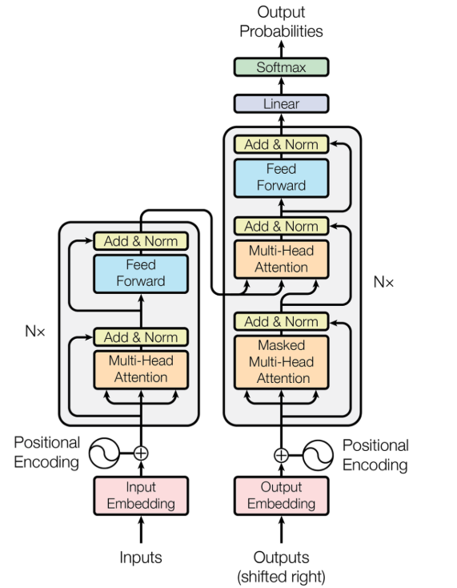
Transformer Complexity
These are the Key Transformer parameters that determine the dominant compute and memory complexity
Batch Size : B
Sequence Length : N
Hidden Dimension : D
Number of Layers : M
Compute/Memory Complexity
O(M*B*N^2*D + M*B*N*D^2) & O(B*M*N^2 + B*M*N*D)
First term is from the Attention operation and the second from Q,K,V Projection.
The Feed Forward complexity is not being considered here
For large Context Windows N dominates (Prefill), for smaller context sizes, D dominates (Decode).
Prefill is Compute Bound
Decode is Memory Bound
Determined by Arithmetic Intensity (Y) of the GPU
Y= FLOPS/Memory_Bandwidth (vRAM and the GPU Core)
If (Compute/Byte-Transfered) >= Y (compute bound)
Else Memory Bound
E.g. for H100, the Y ~295
Transformer Architecture (Vaswani et al, 2017)

Slide 9
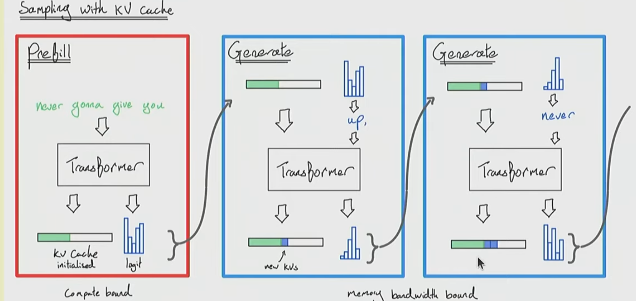
KV Caching
In a vanilla feed forward case, if there are T tokens to the generated, the total compute is O(T^3)
Compute Bound, but higher ITL
KV Caching is used to improve ITL latency by trading of compute for memory
Need to transfer the KV cache for each Decode makes it Memory Bound
Arithematic Intensity ~ O(B*N), N=1 for Decode, hence B has to be high (may not be feasible)
In the first pass, the KV cache is saved, that is incrementally used in the decode phase for next token generation
Since the KV Cache can be 10’s of GB (~ B * N *#of Layers* hidden_dim), for a single request, has to be stored in the HBM
Fig from – CS336, Stanford, Youtube

Slide 10
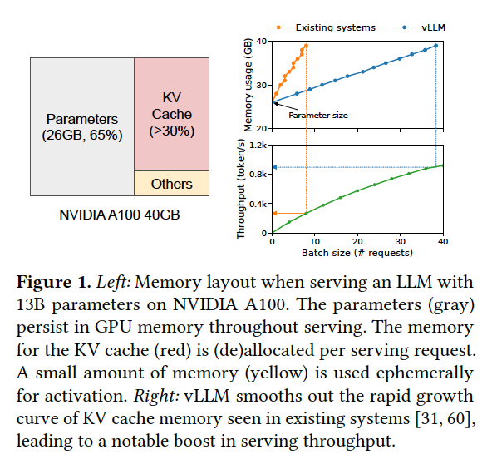
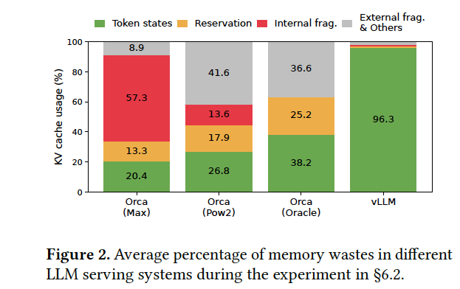
Paged Attention
Addresses the memory fragmentation of the GPU resources because of inefficient usage of the KV Cache
Earlier technique was to reserve KV Cache considering the worst case Prompt + Output Token KV Cache/Prompt (e.g. 2k Tokens)
Each token can take 800KB-1MB or more
(2(K/V) *# of layers* hidden_dim*2) (FP-16)
Memory for 2K tokens/request ~ 1.6GB
Paged Attention
Memory manager maps the tokens to the KV memory blocks of the GPU
Logically sequence tokens can map to discontinuous Physical Memory blocks
KV Blocks can be reused across prompts and different decoding strategies
Parallel Sampling, Beam Search, Prefix Sharing
Reuse is at the granularity of a Block, if a Block is only partially filled then a new copy of it is made

Slide 11
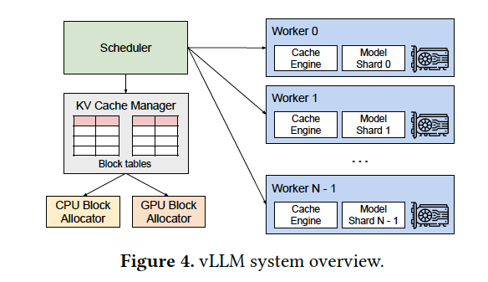
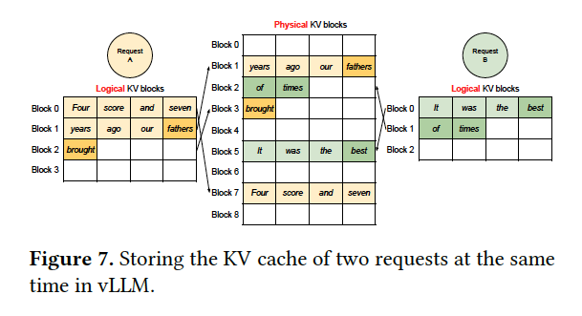
vLLM System View
Schedular manages the memory pool of the GPU and maps incoming requests to available Blocks in the pool
KV Cache manager, manages the Block Table, that is stored in the GPU, maps the logical KV blocks to physical blocks
The CPU Schedular interfaces with the GPU Kernels to manage the Block table used during the Prefill and Decode stages
Shows how the KV Caches can be used across multiple user requests

Slide 12
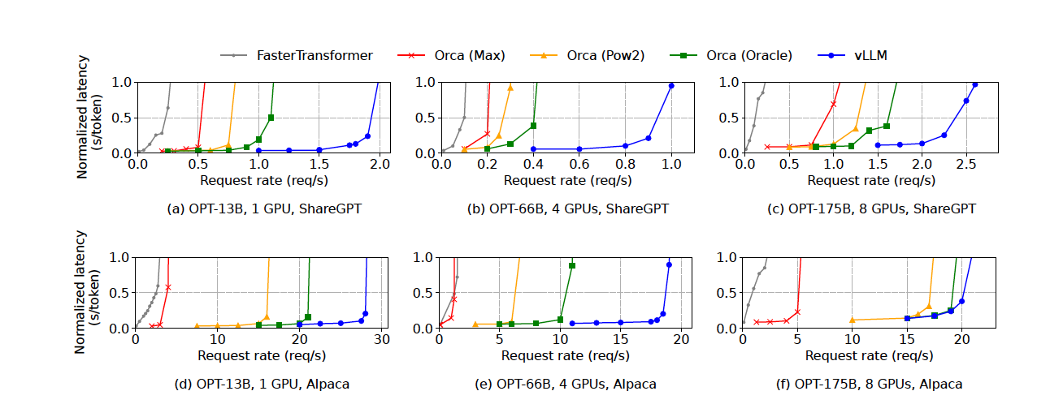
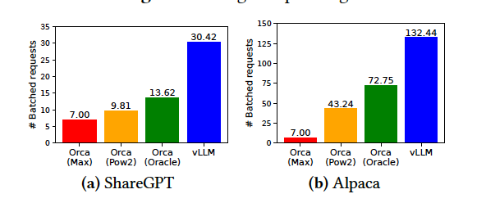
Results
vLLM can serve higher req/s before saturating the GPU resources

Slide 13
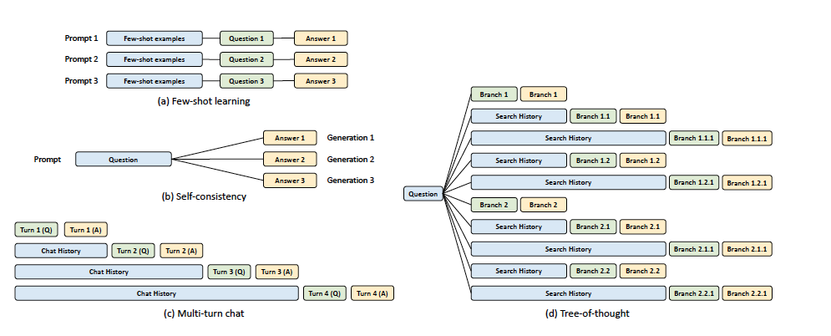
Radix Attention
Paged Attention Optimized for a single Prompt Request (KV cache discarded after a request is satisfied)
Radix Attention extends this to optimize across multiple Prompt Requests (preservs KV Cache across user requests)
Use cases – Few Shot Learning, Multi-Turn Chat, Tree-of-Thought
Paper report 6.4x higher throughput and Latency by 4x than vLLM
[1] Sglang Paper

Slide 14
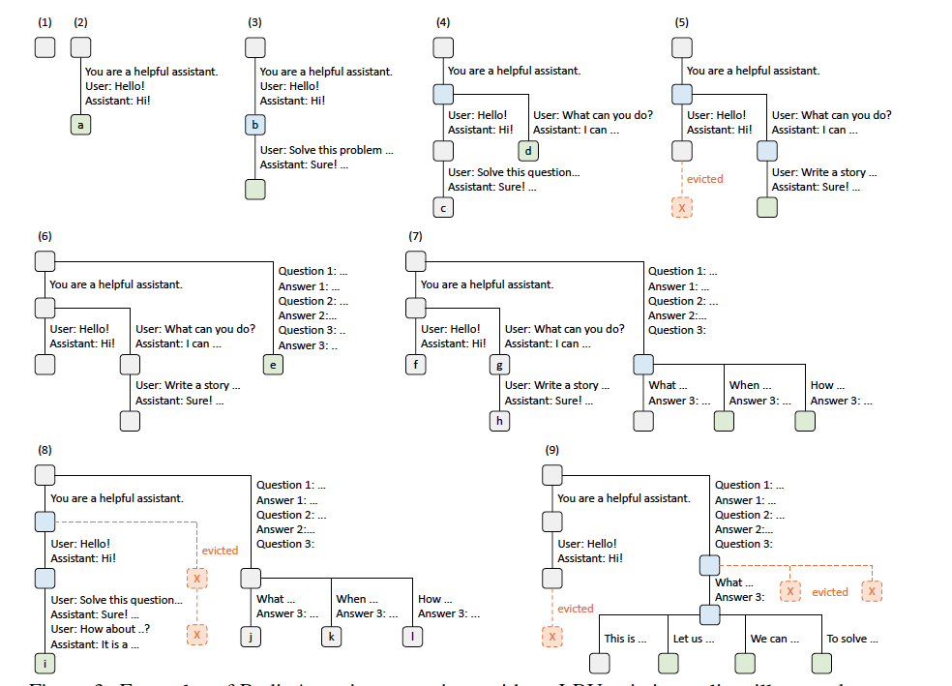
Radix Tree Management
Radix Tree manages the mapping between sequences of token and KV Cache Tensors
This is memory intensive, hence techniques like LRU is used to evict least recently used leaf first
Cached tokens and active requests share the same memory pool
The Tree itself is stored in the CPU, a table maps the nodes to the GPU’s memory block
Cache aware scheduling is used to prefer longer prefix matched requests are prioritized to maximize the cache hit ratio.
Evolution of the Radix Tree

Slide 15
Prefix Caching
Persist KV Caches for Prefix Caching
System Prompt (e.g. when using OpenAI’s APIs)
Multi-Turn Conversations
Long Documents
More recent use cases
Inference-time scaling (e.g. reasoning and planning tasks)
Long-context models
Notes:
OpenAI adds about 4k header before processing each prompt

Slide 16
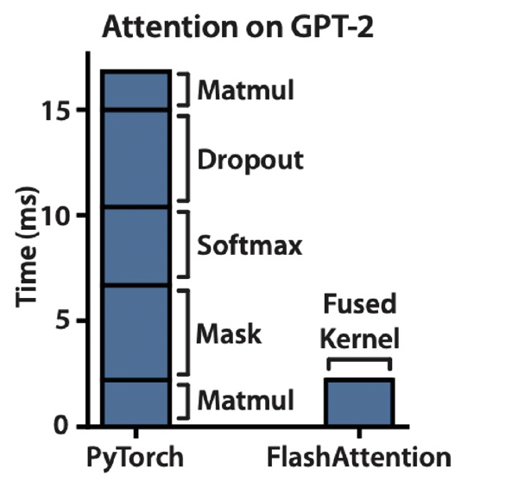
Flash Attention
Standard Attention compute requires to compute NxN matrix (where N is the number of tokens)
Flash Attention [1] reorders the math into Tiles that fit in a GPU SRAM (on-chip). It computes and applies the Softmax on the fly without storing the whole Q,K,V matrix
Implemented as part of the Attention kernel where Q*K^{T} / V is applied.
Improves Latency and Throughput
[1] Flash Attention Paper

Slide 17
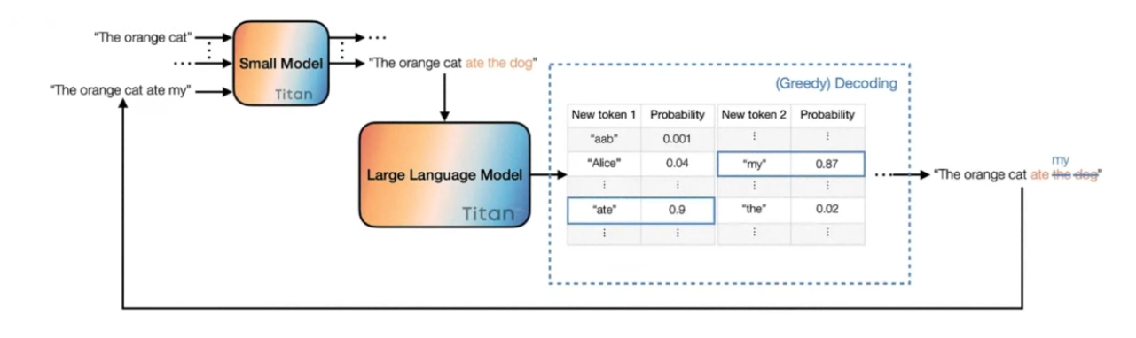
Speculative Decoding
This approach is to increase the Arthematic Intensity for a given GPU system.
A draft model (smaller model) is used to generate future tokens, and then these tokens are appended to the prompt and made to verify by the larger GPU
This would be equivalent of the Prefill, resulting higher GPU utilization
[1] Minghao et al, “Decoding Speculative Decoding”, NAACL, 2025

Slide 18
How to choose the draft model ?
Objective – Draft must be fast and accurate enough so that the large model rarely rejects the tokens, and avoid duplication of compute
Smaller sibling model
Use a smaller version from the same family (e.g. Llama-2-7B for Llama-2-70B)
Same Tokenizer , correlated predictions
Still requires 2 models
Distilled model
Train small student to mimic large Teacher
Higher Allignment, fewer Mismatches
Quantized Copy
Run a quantized (INT 8/4) vesion as a draft
Faster, similar predictions

Slide 19
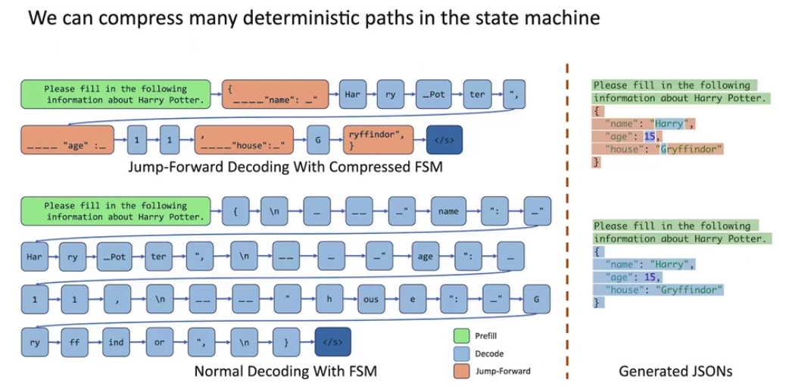
Constraint Decoding
Combines the logic of Decoding with the FSM required in the output
Use cases – Output based on JSON format + Regex , Latex etc.
# of times Decoder is invoked ~ 4
# of times Decoder is invoked ~ 40 (10X)
Diagram Ref: https://huggingface.co/blog/paresh2806/sglang-efficient-llm-workflows

Slide 20
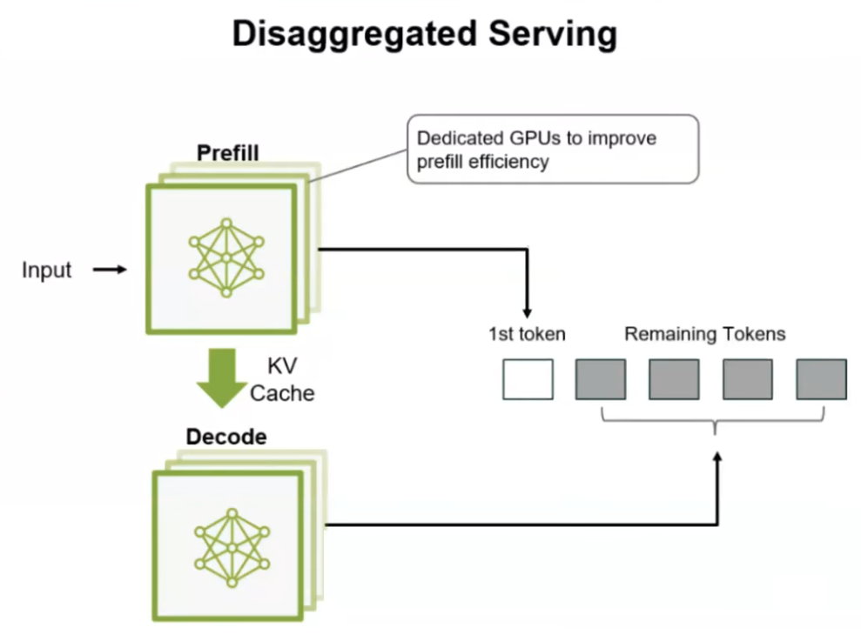
P/D Dissagregation
To physically decouple the Prefill computation from the Decode
Scale independently and better interleaving of user request
Prefill and Decode can work on different hardware considering their compute/memory bound nature
Efficiency depends on the distribution of the Input/Output Sequence Length (ISL/OSL)
Adapting the P/D workers to dynamic changes in the ISL/OSL distribution is a considerstion.
Request 1
Request 2
Prefill
[1] Yinmin Zhong et al, “DistServe: Disaggregating Prefill and Decoding for Goodput-optimized LLM Serving” https://arxiv.org/pdf/2401.09670
KV Cache Transfer
KV Cache Transfer
Decode
Notes:
Fig from - https://www.youtube.com/watch?v=wFMZ4fuHFo0&t=281s

Slide 21
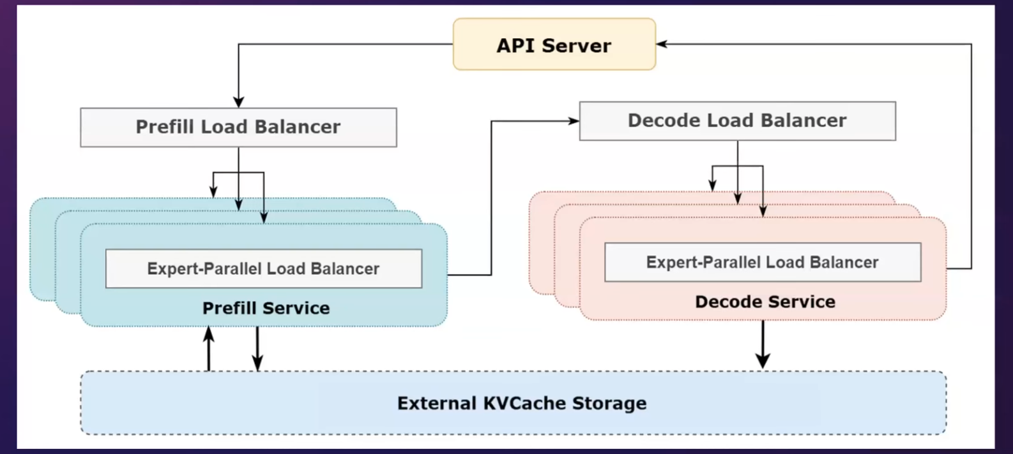
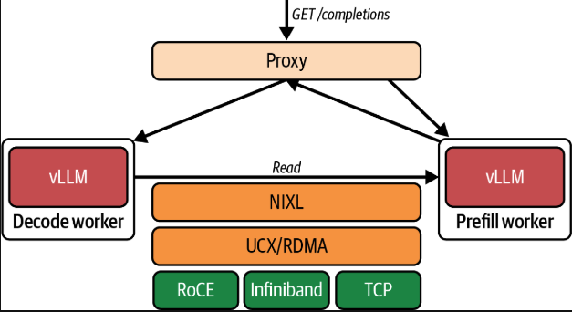
Distributed P/D Architecture
High speed networking (e.g. NIXL/ROCEv2) allows instantaneous transfer of the KV Cache within Server or b/w Servers
vLLM integrates with NIXL
Further decomposition of functions using the Load Balancer for Prefill and Decode can enable scalable and SLO oriented inferencing

Slide 22
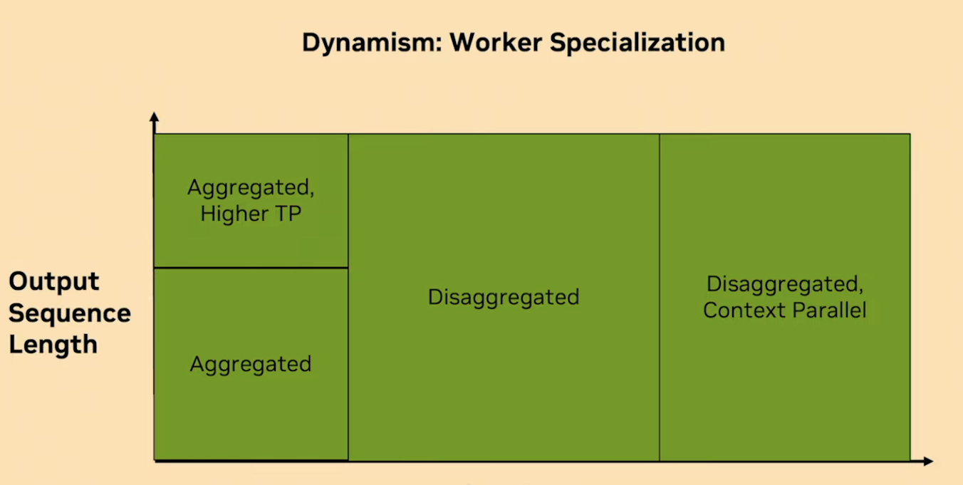
P/D Disaggregation: Dependency on ISL/OSL
Input Sequence Length
Source: Nvidia

Slide 23
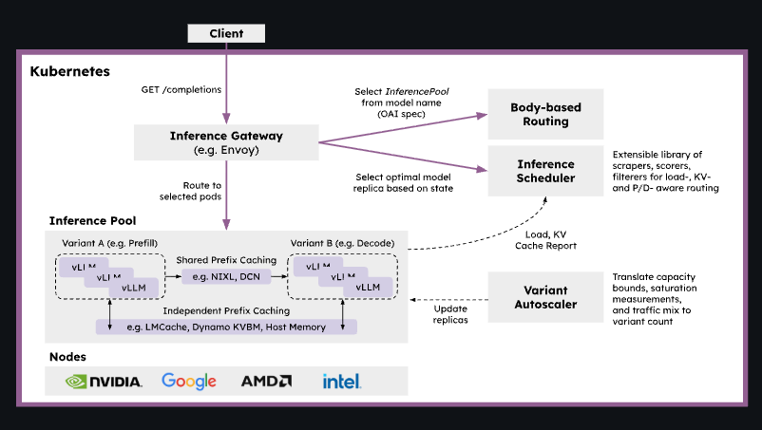
Llm-d
vLLM implements disaggregated prefilling by running two instances and handing off KV using LMCache and NIXL
llm-d extends this with Kubernetes native orchestration for disaggregated serving and KV-aware routing.
[1] https://github.com/llm-d/llm-d
Notes:
In modern inference deployments, all nodes can perform both prefill and decode functionality since they all share the same runtime and code base (e.g., vLLM, SGLang, NVIDIA Dynamo, etc.). It’s up to the cluster orchestrator to assign them a specific role, either prefill or decode, statically upon startup—and dynamically throughout the worker’s lifecycle.

Slide 24
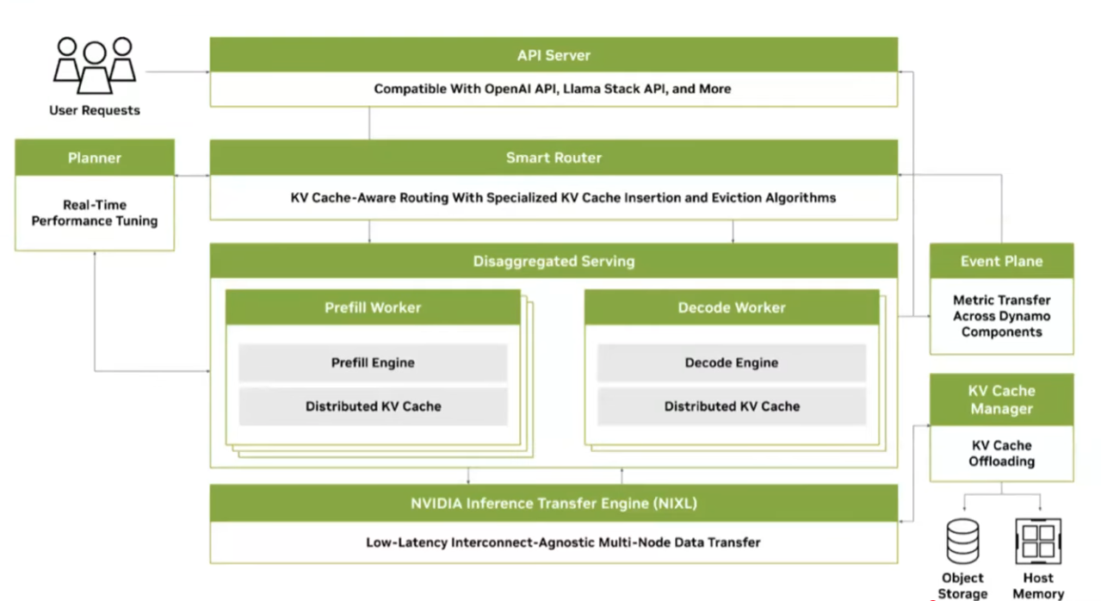
Nvidia’s Dynamo P/D Disaggregated Architecture

Slide 25
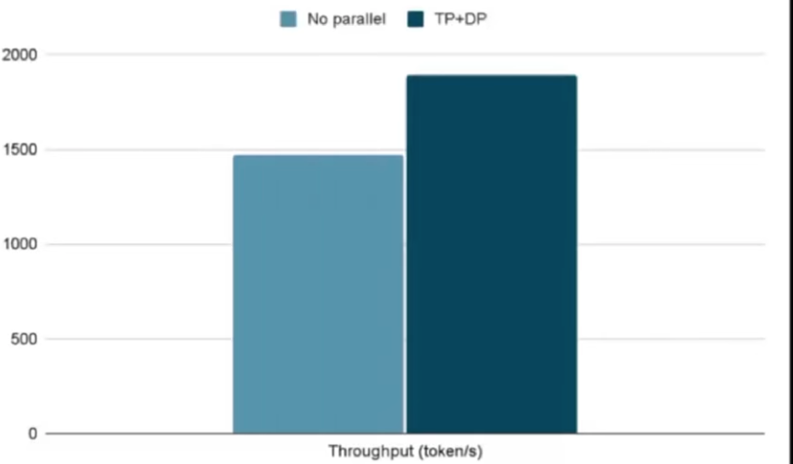
Multi-GPU Parallelism during Inferencing
Easy throughput gain during inferencing can be achieved by replicating the model on N GPUs
If the model its fin a GPU
Sharding is required if the model doesn’t fit in a GPU
TP is usually used within the Server because of the high bandwidth inter-connect.
But there is a trade-off when bigger batches are applied to a TP alone
Graph shows the throughput gain when TP is used in combination with DP
For e.g. a 2 x 4 (DP X TP) means a two GPU clusters with 4 TP, serving multiple different batches of data
Popular combination of parallelism used during inferencing
TP + DP
TP + DP + EP
Optimization consideration here is on the overhead of communication (All-Reduce, Reduce Gather etc.), Batching

Slide 26
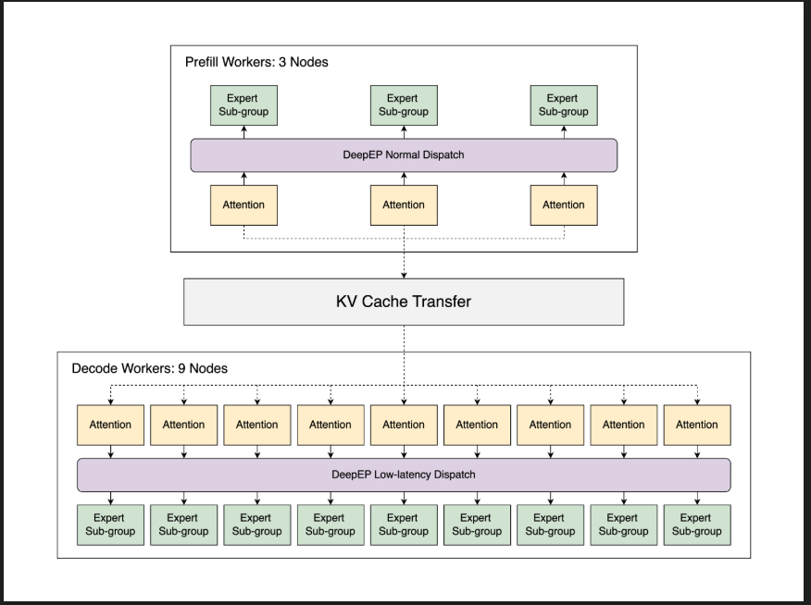
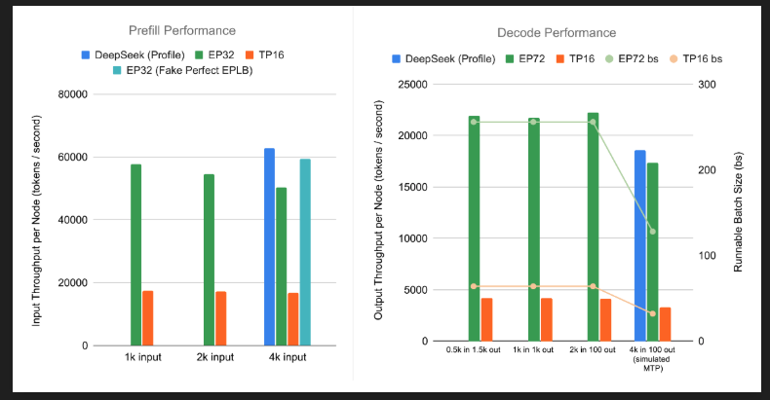
Large Scale Expert Parallelism
Ref : https://lmsys.org/blog/2025-05-05-large-scale-ep/

Slide 27
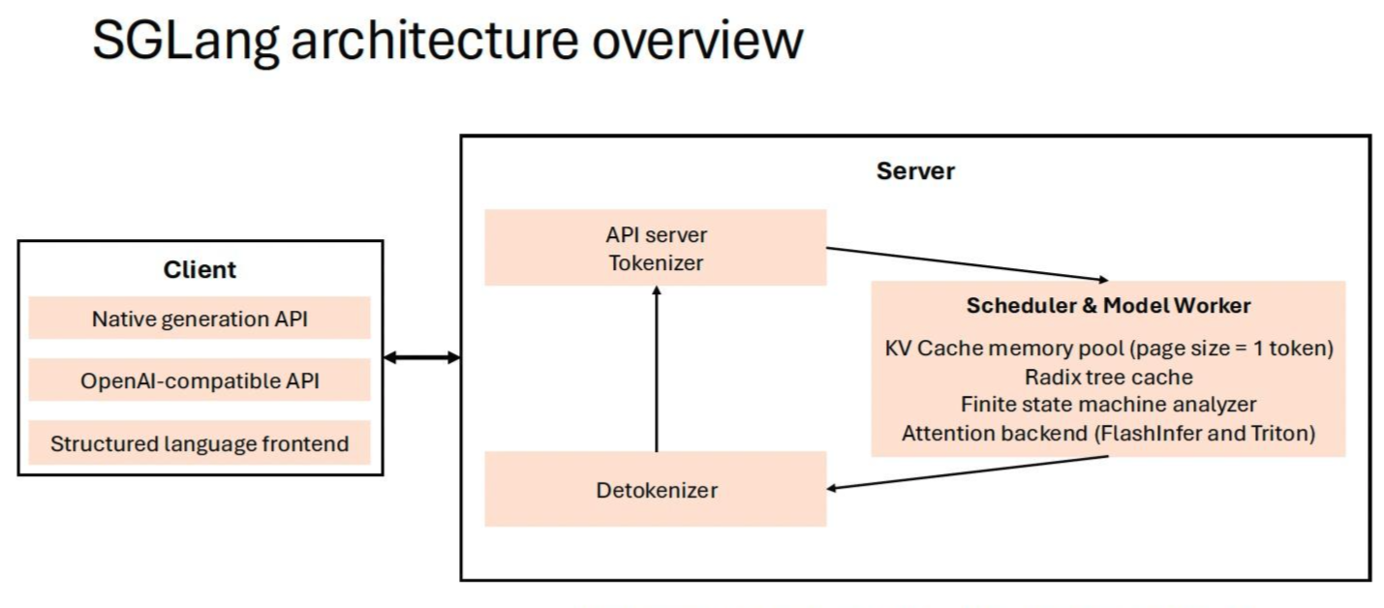
SGLang
Architecture Functional Components
Front End DSL
BackEnd Engine
API Server Tokenizer
Schedular
..
Optimization Features
Radix Attention
Continuous Batching
Multi-Modal Support
Structured/Constrained Output
PD Disaggregation
Distributed Inference
Quantization

Slide 28
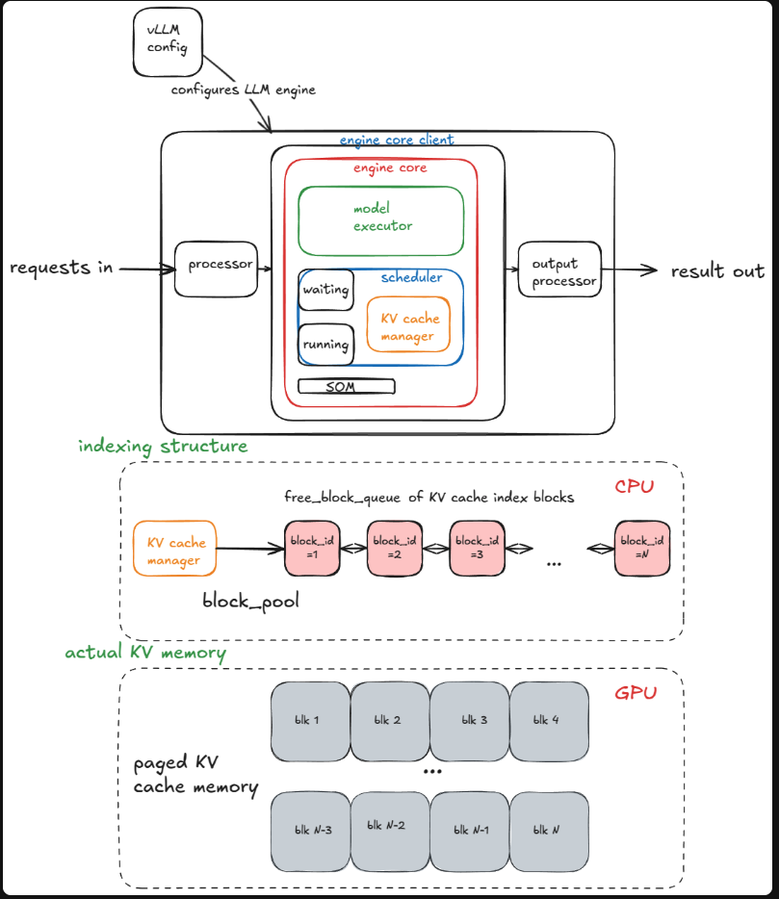
vLLM Architecture
Key Architecture functions:
Engine Core
Schedular
KV Cache Manager
Optimization implementations
Paged Attention
Ref: https://www.aleksagordic.com/blog/vllm

Slide 29
Backup

Slide 30
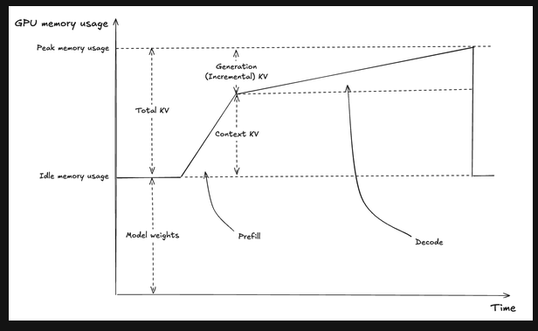
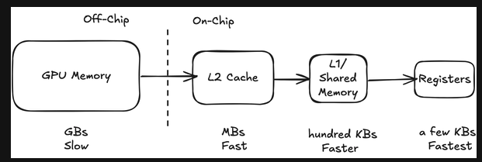
KV Caching
In a vanilla feed forward case, if there are T tokens to the generated, the total compute is O(T^3)
Compute Bound, but higher ITL
KV Caching is used to improve ITL latency by trading of compute for memory
Need to transfer the KV cache for each Decode makes it Memory Bound
In the first pass, the KV cache is saved, that is incrementally used in the decode phase for next token generation
GPU’s have 3 layers of memory, HBM and L2/L1 cache
Since the KV Cache can be 10’s of GB for a single request, has to be stored in the HBM
Figs from [1] in Reference.

Slide 31
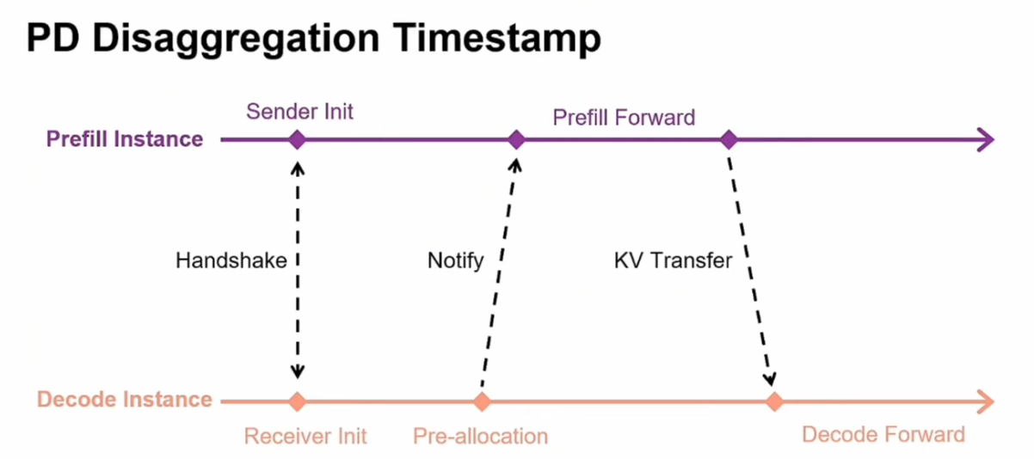
Key features
Radix Attention
Continuous Batching
Multi-Modal Support
Structured Output
Distributed Inference
Quantization
PD Dissagregation

